Slide 2
Interpolation of loudspeaker level balloons from polar measurements by using deep learning
Víctor Manuel Catalá Iborra¹
¹ DAS AUDIO GROUP, Fuente del Jarro, Spain

Slide 3
Loudspeaker radiation balloon (level and phase)

Slide 4
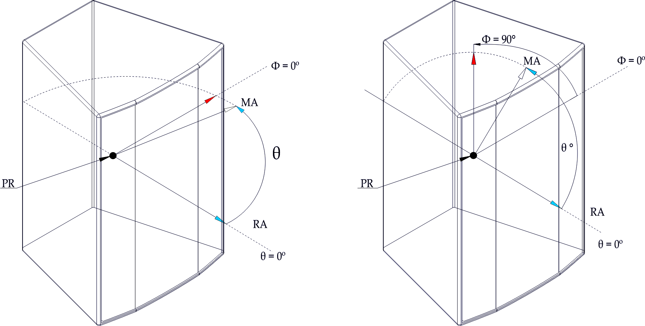
Polar system coordinates per AES, 2008 (reaffirmed 2014).

Slide 5
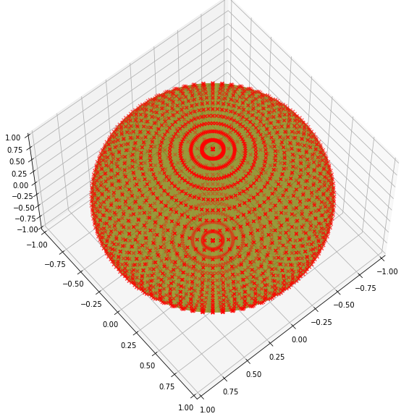
2664 measurement points which means 82584 SPL values with 1/3 oct resolution

Slide 6
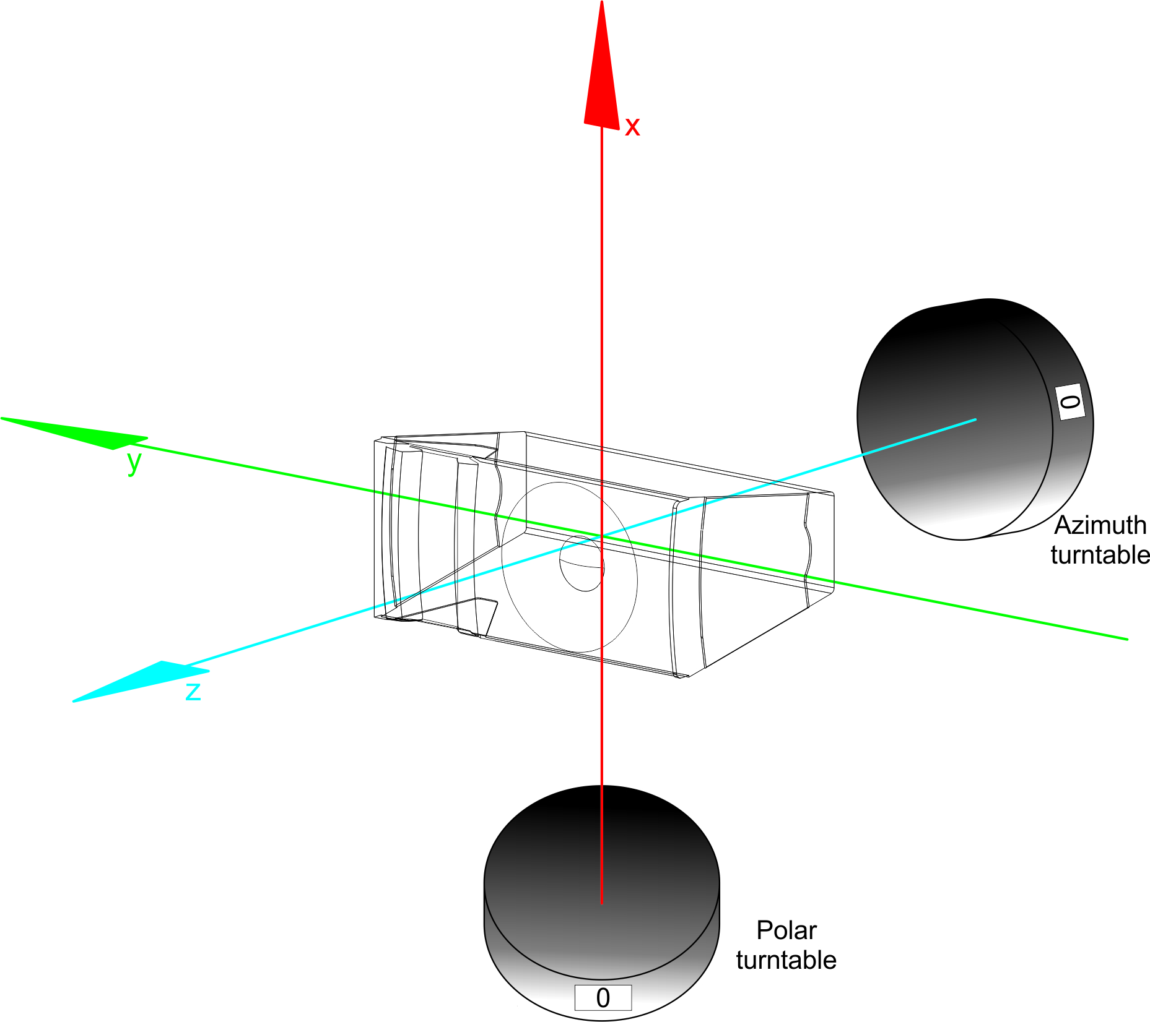
Graph following 3D acquisition system description at Clio Software application note AN-002.

Slide 7
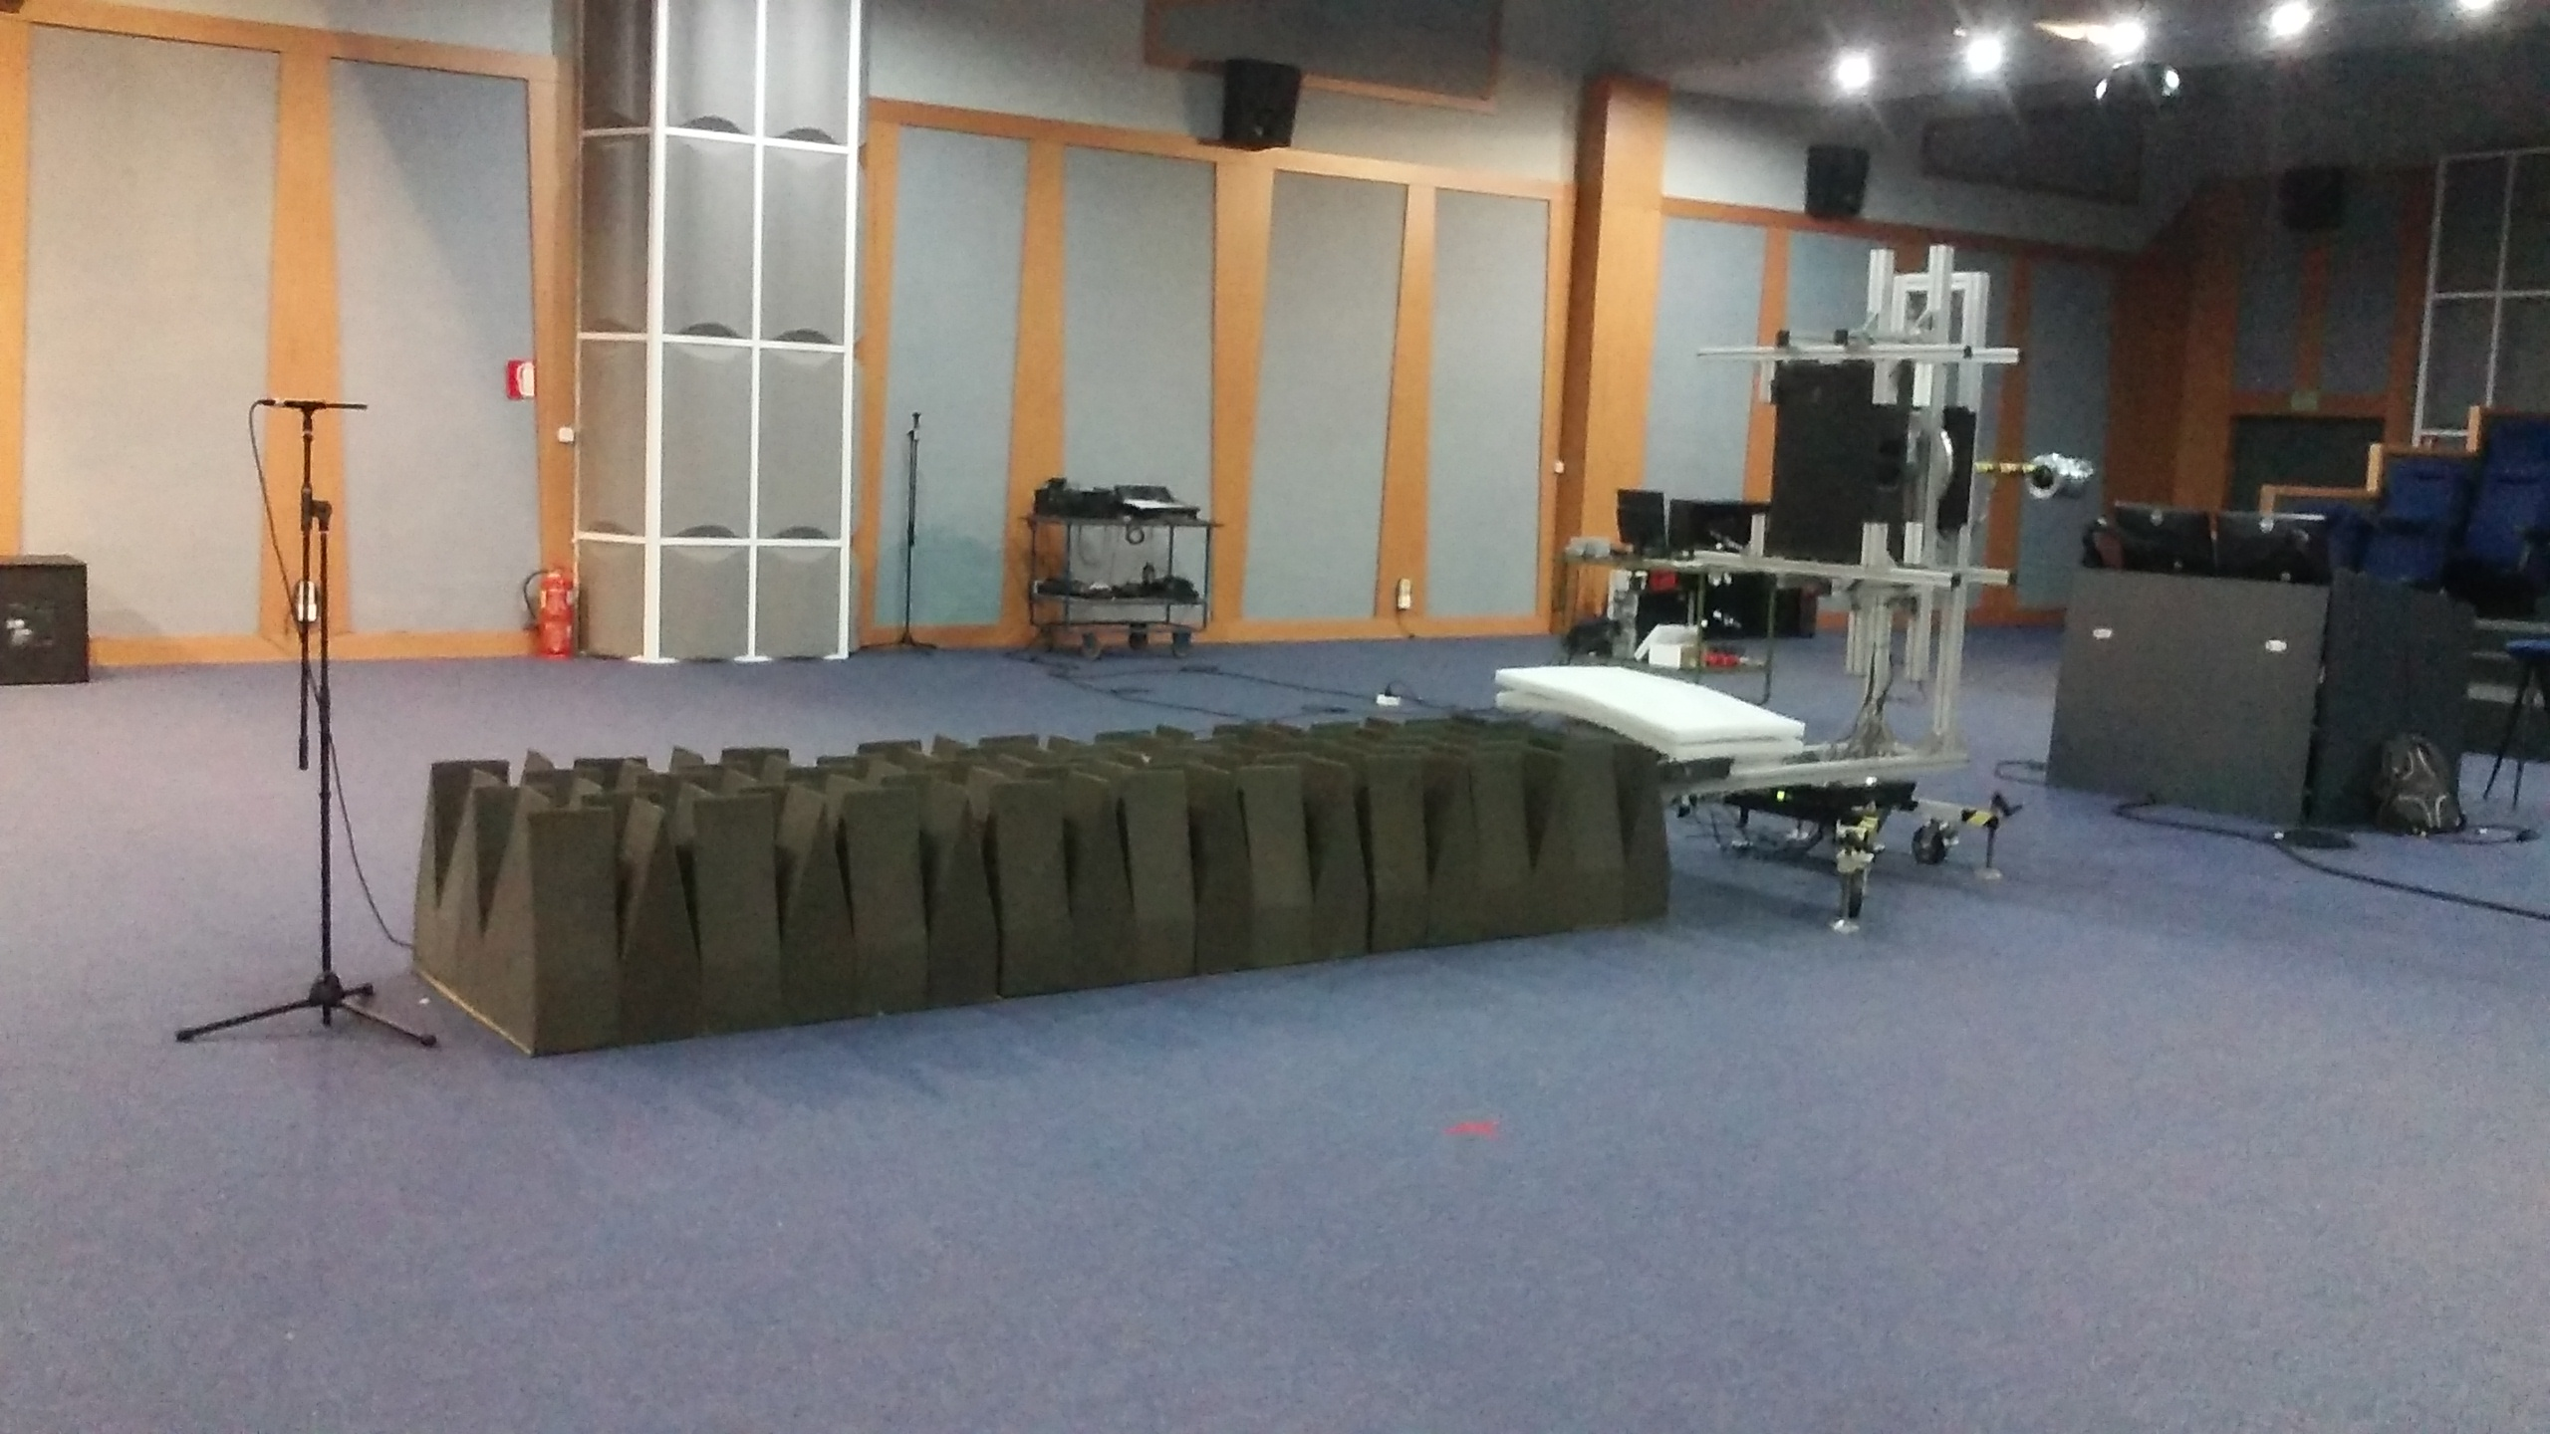
Measurement set-up at DAS Audio Auditorium.

Slide 8
Loudspeaker radiation balloon (level and phase)

Slide 9
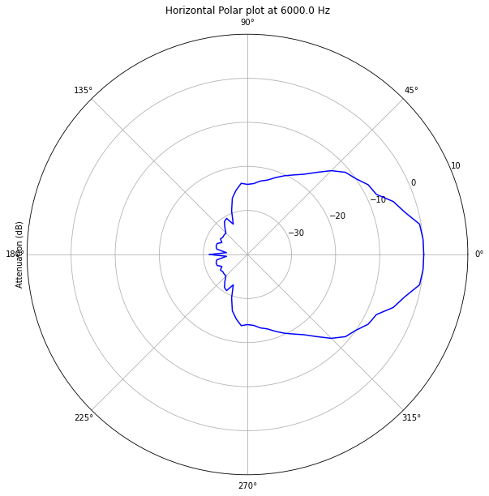
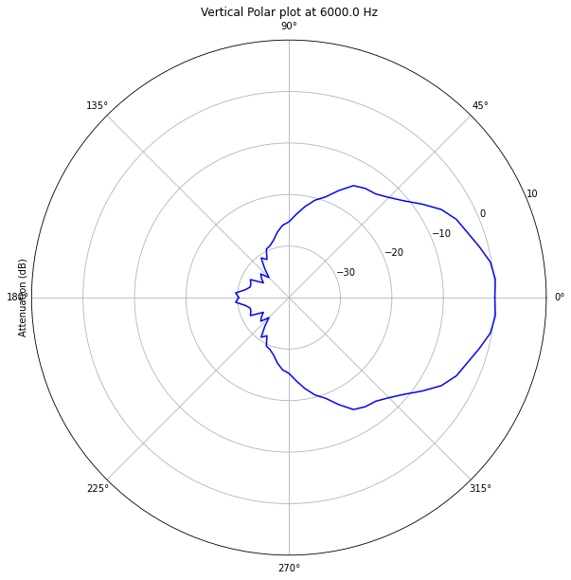
Polar diagrams.

Slide 10
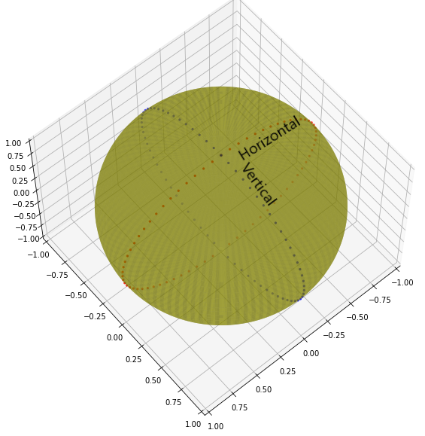
Horizontal (red) and vertical (blue) polar measurement points.

Slide 11
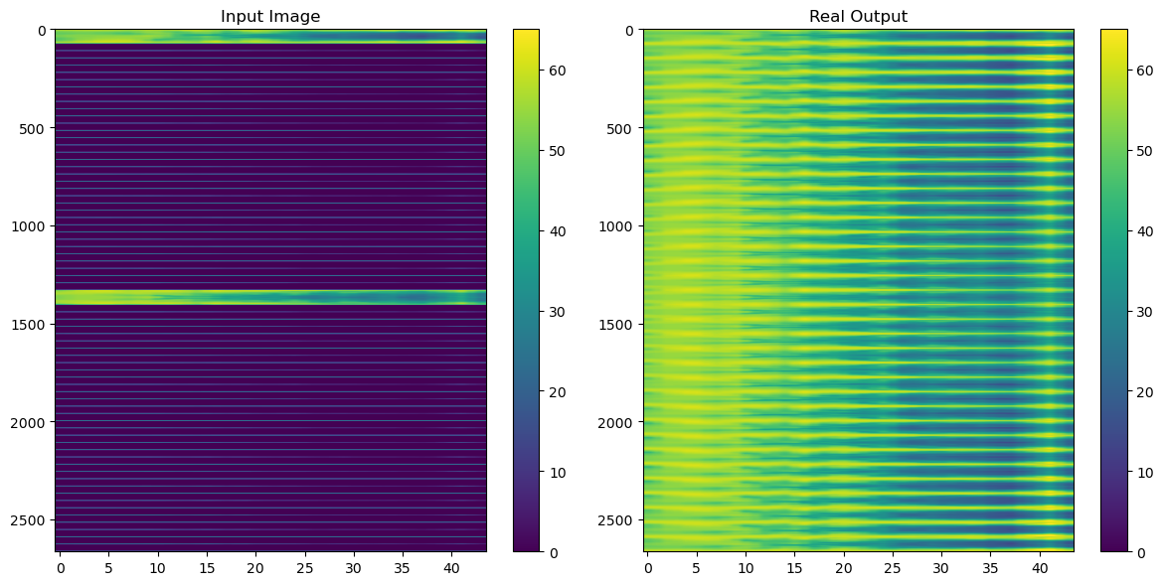

Slide 12
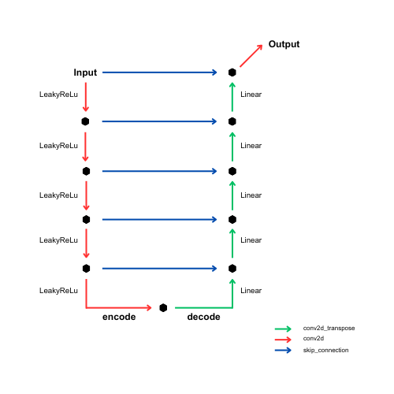

Slide 13
Layer Input size Stride Padding Kernel size Output size
conv2d_44 (2664, 44, 1) (2, 1) valid (75, 3) (1295, 42, 16)
conv2d_45 (1295, 42, 16) (2, 2) valid (75, 3) (611, 20, 32)
conv2d_46 (611, 20, 32) (2, 2) valid (75, 3) (269, 9, 64)
conv2d_47 (269, 9, 64) (2, 2) valid (75, 3) (98, 4, 128)
conv2d_48 (98, 4, 128) (2, 2) valid (75, 3) (12, 1, 256)
conv2d_transpose_32 (12, 1, 256) (2, 1) valid (76, 4) (98, 4, 128)
conv2d_transpose_33 (98, 4, 256) (2, 2) valid (75, 3) (269, 9, 64)
conv2d_transpose_34 (269, 9, 128) (2, 2) valid (75, 4) (611, 20, 32)
conv2d_transpose_35 (611, 20, 64) (2, 2) valid (75, 4) (1295, 42, 16)
conv2d_transpose_36 (1295, 42, 32) (2, 1) valid (76, 3) (2664, 44, 16)
conv2d_49 (2664, 44, 17) NA same (75, 4) (2664, 44, 1)
Table 1. Parameters of the proposed U-net.

Slide 14
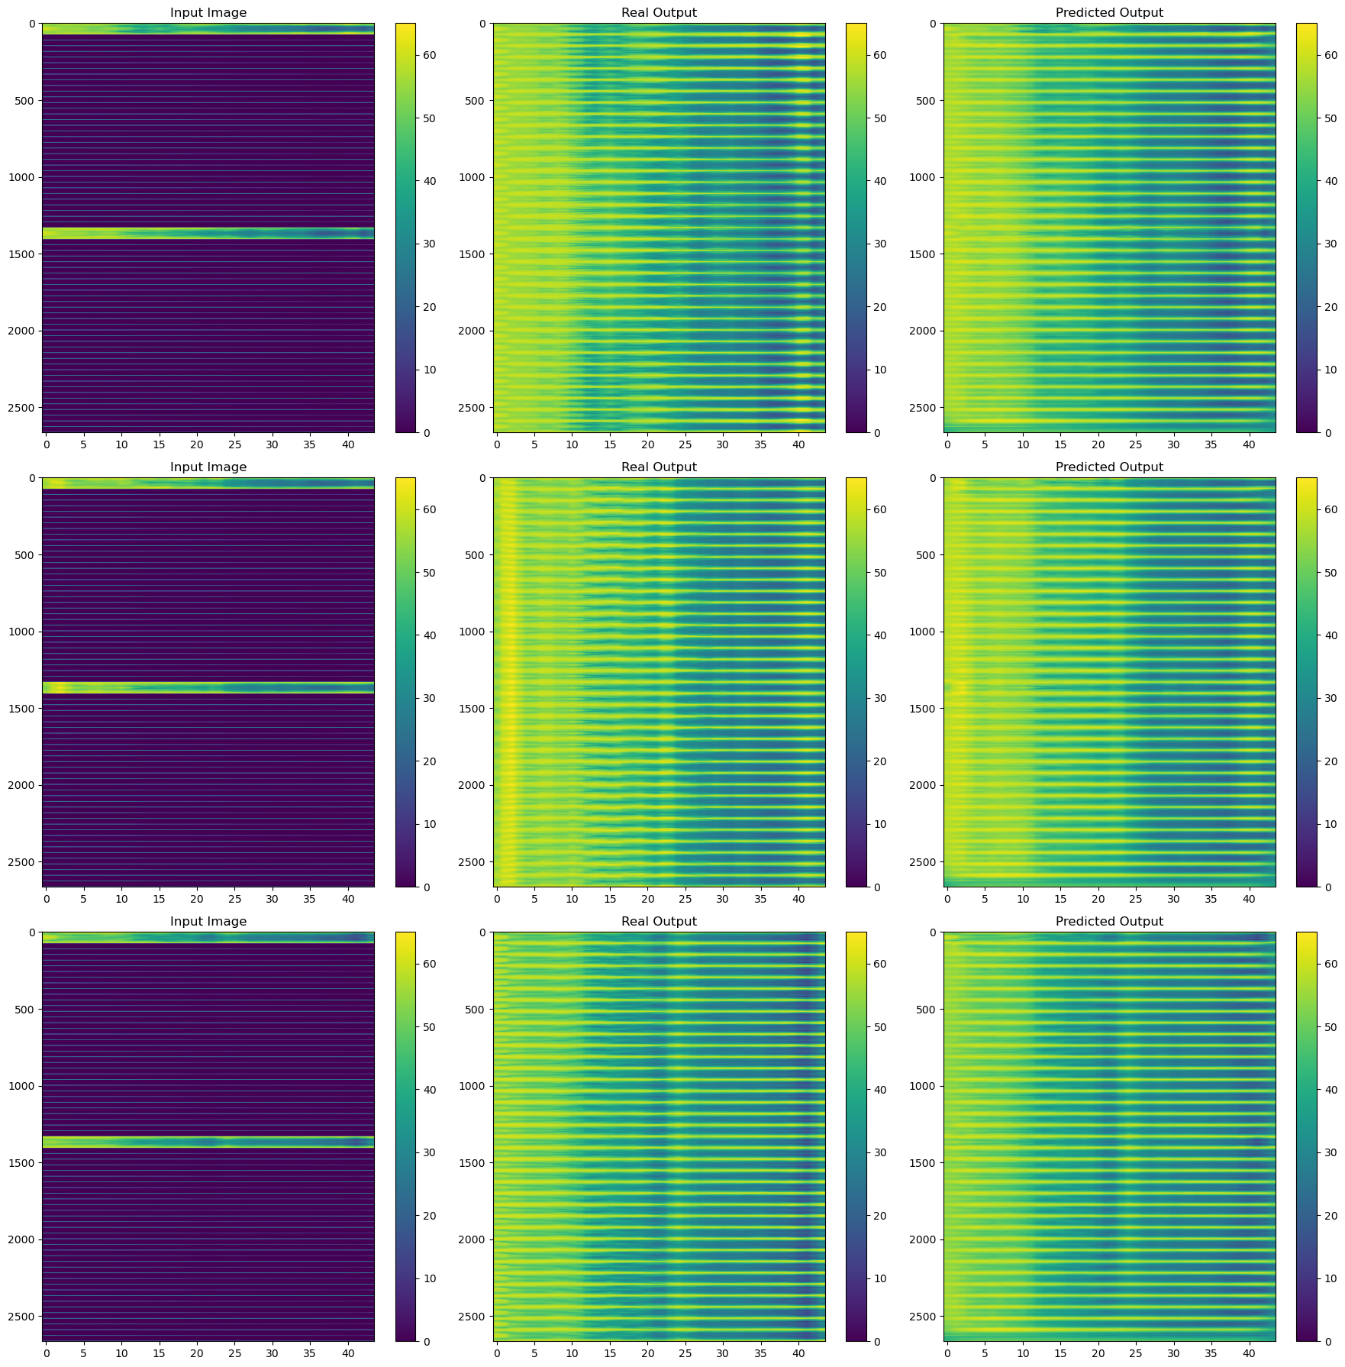

Slide 15
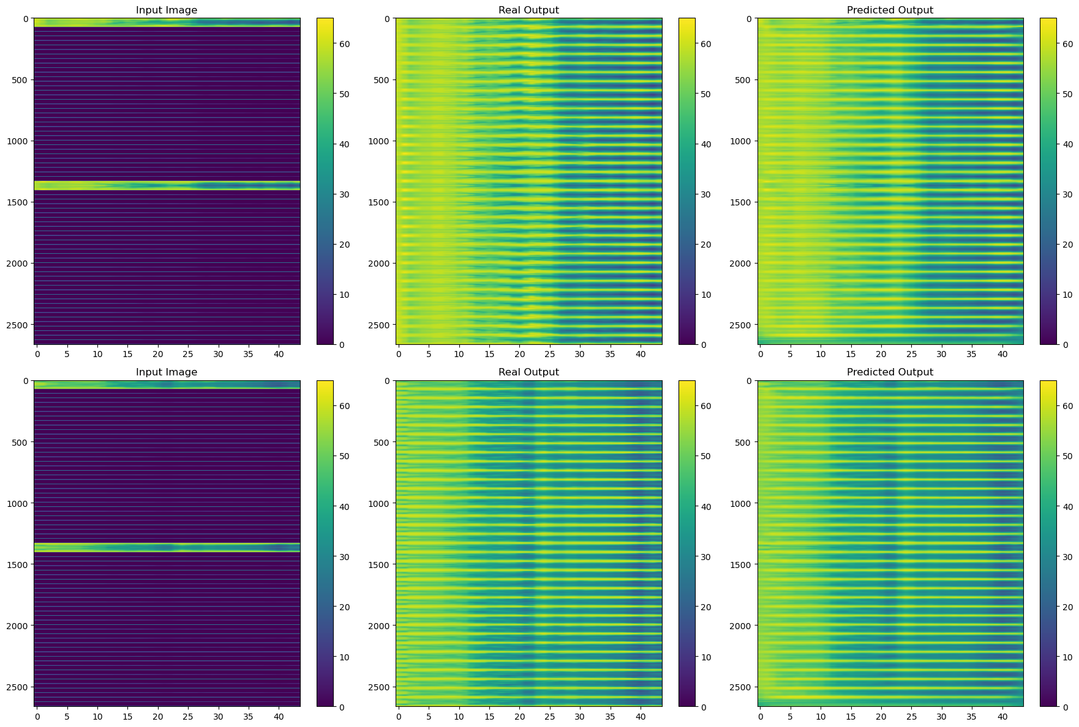

Slide 16
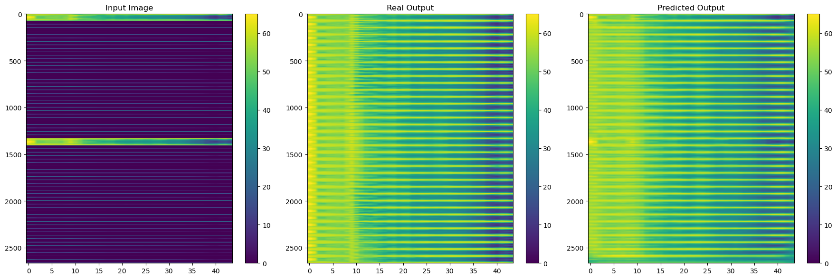

Slide 17
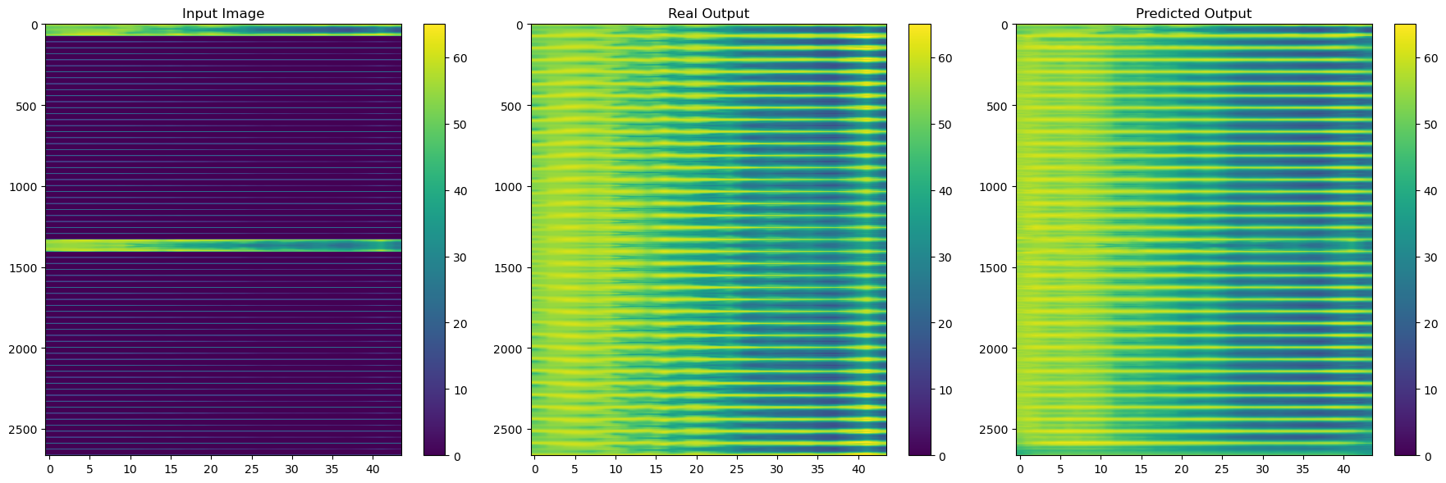

Slide 18
Training data | 2.8 dB
Validation data | 4.0 dB
Test data | 3.8 dB

Slide 19
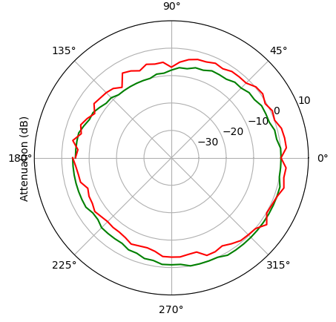
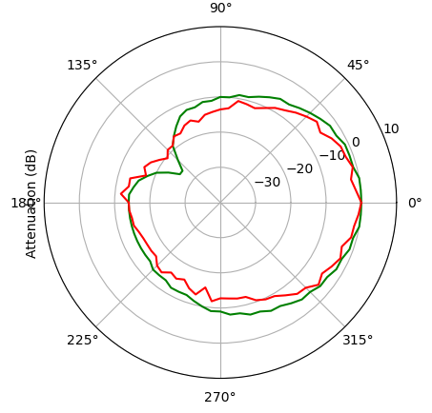
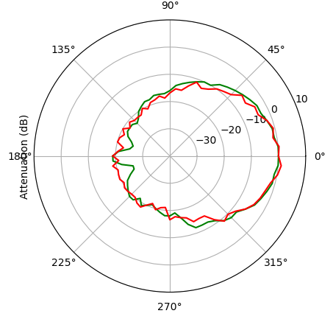
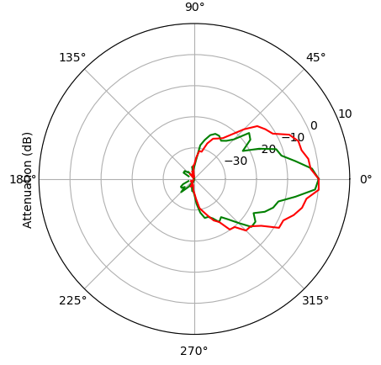
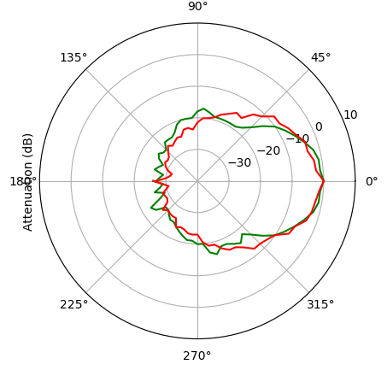
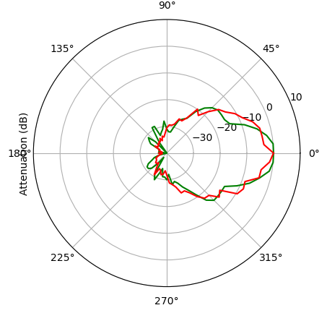

Slide 20
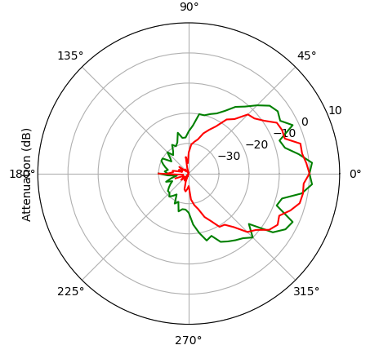

Slide 21
Thanks!

